Slide 1
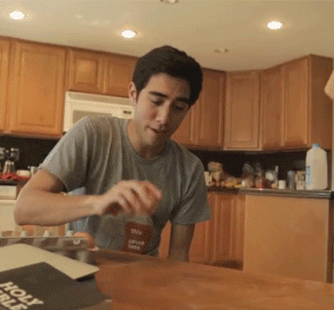
It’s magic!!
What are you doing?

Slide 2
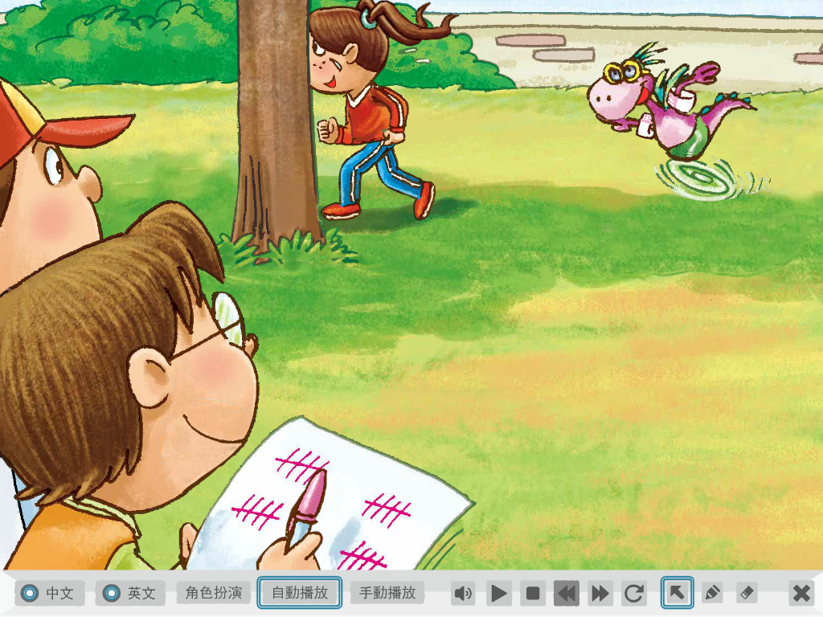
They are running.
They are counting.

Slide 3
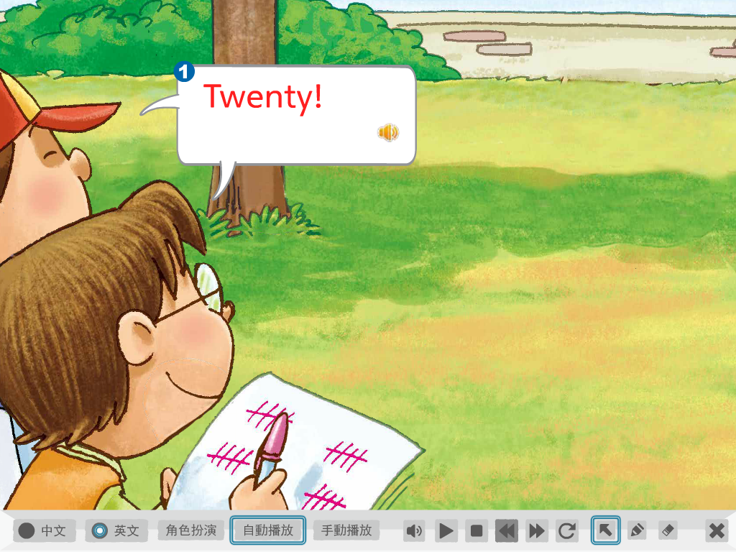

Slide 4
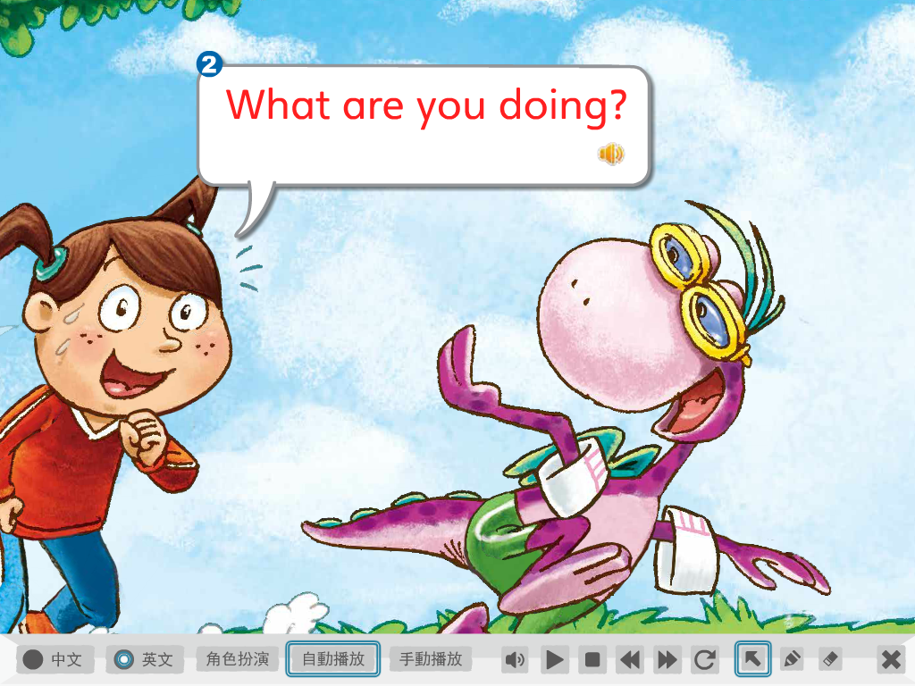

Slide 5
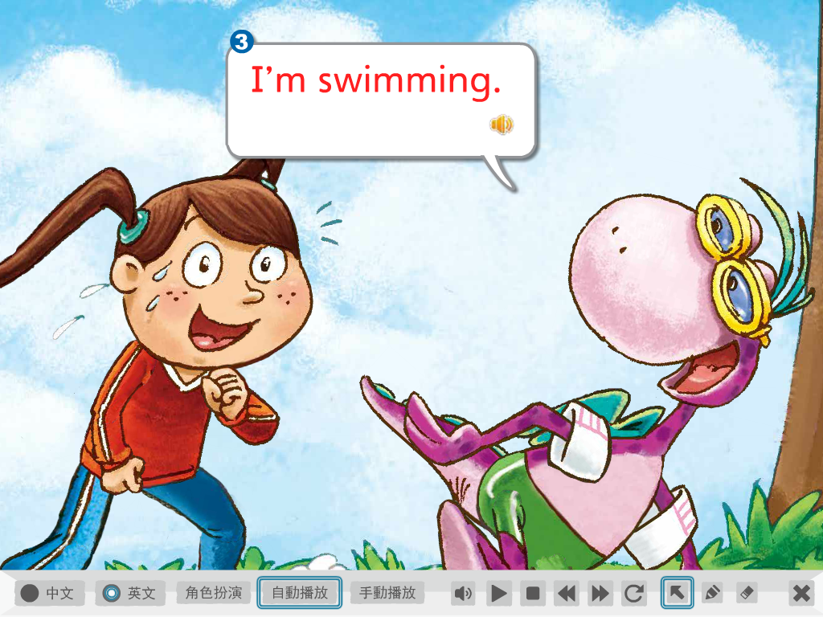

Slide 6
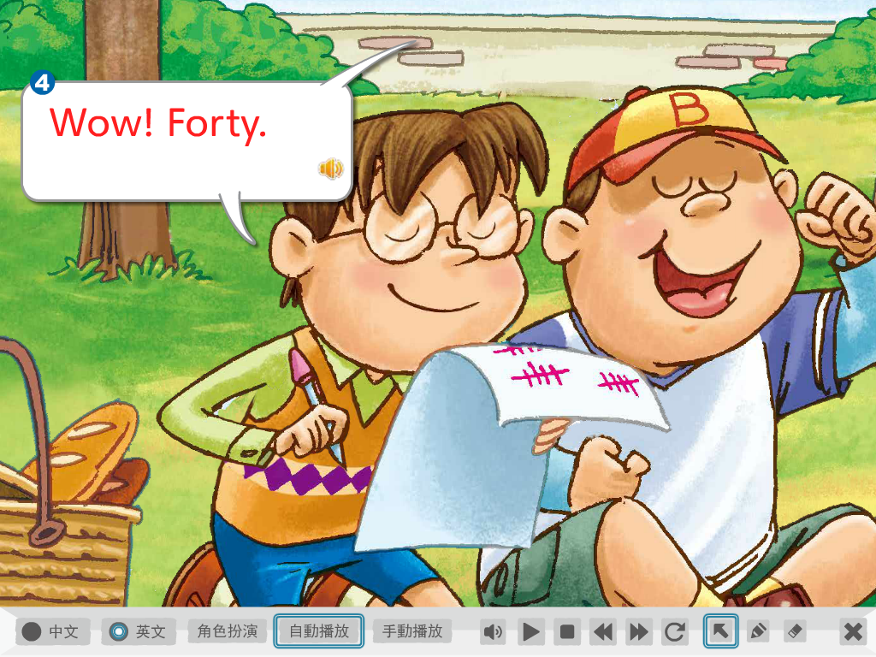

Slide 7
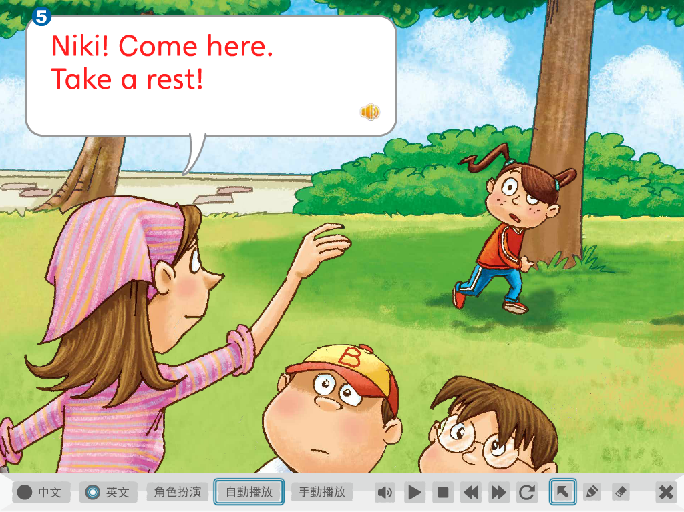
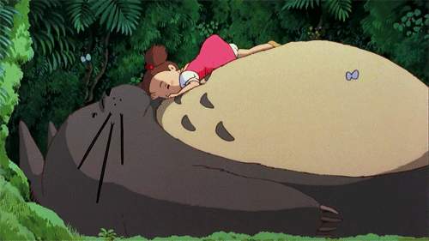
休息一下

Slide 8
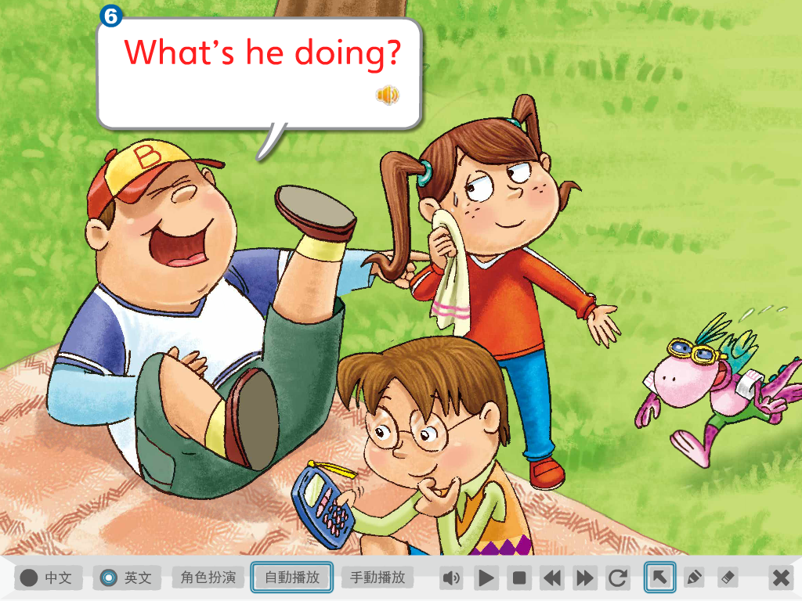

Slide 9
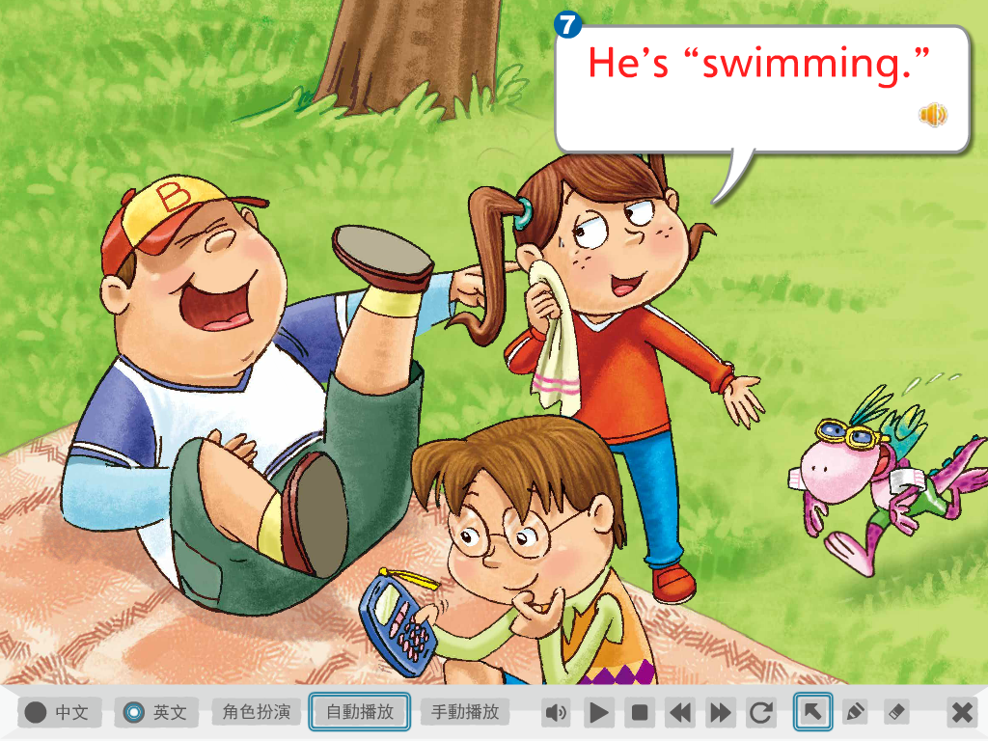

Slide 10
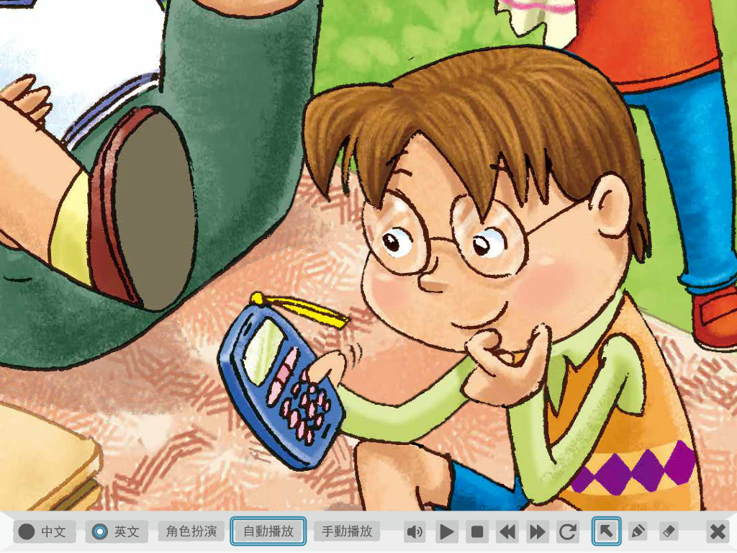
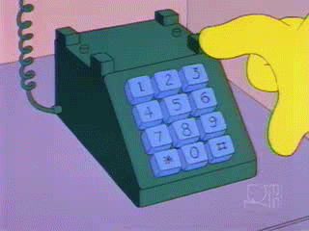
He is making a phone call.
He is dialing number.

Slide 11
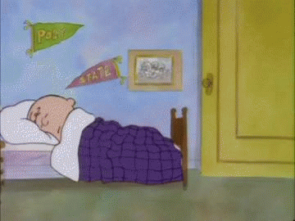
Time to get up!
Rise and shine!

Slide 12
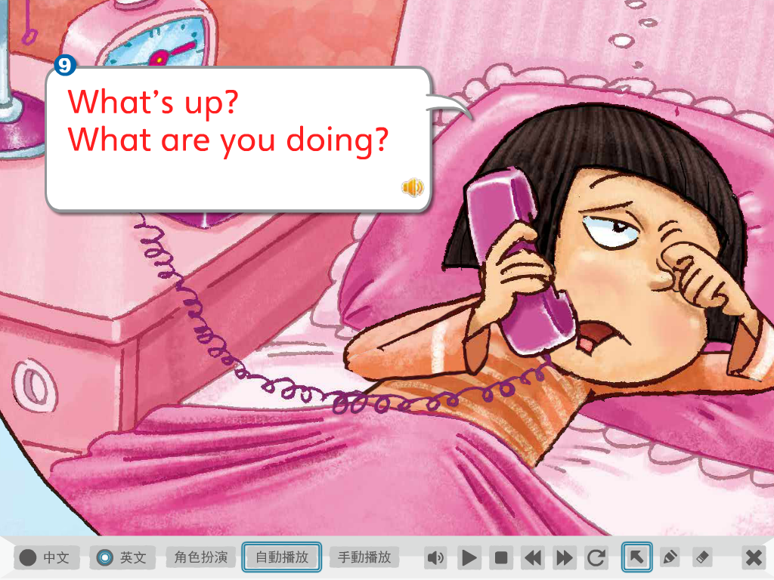
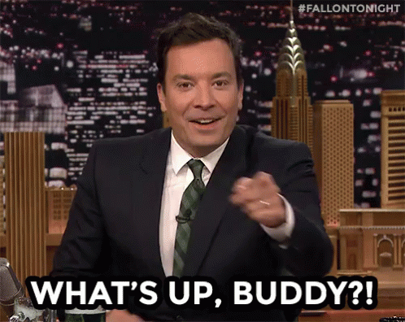
怎麼了? What’s going on?

Slide 13
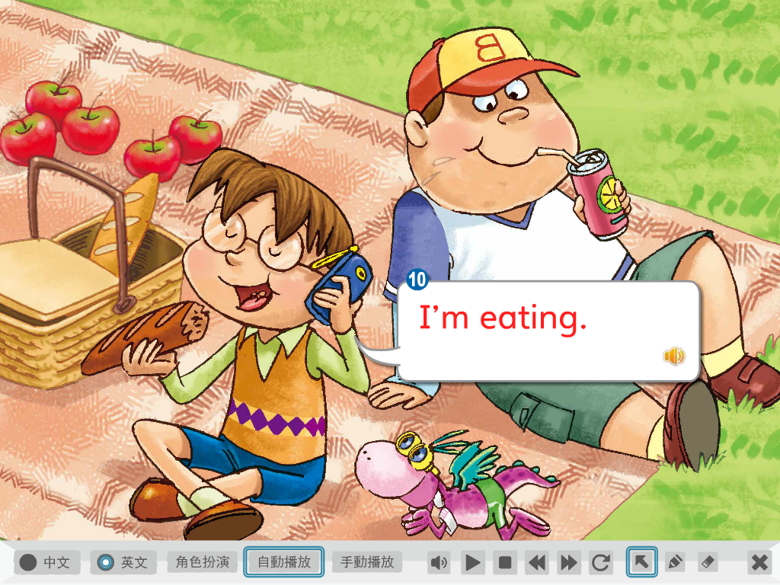

Slide 14
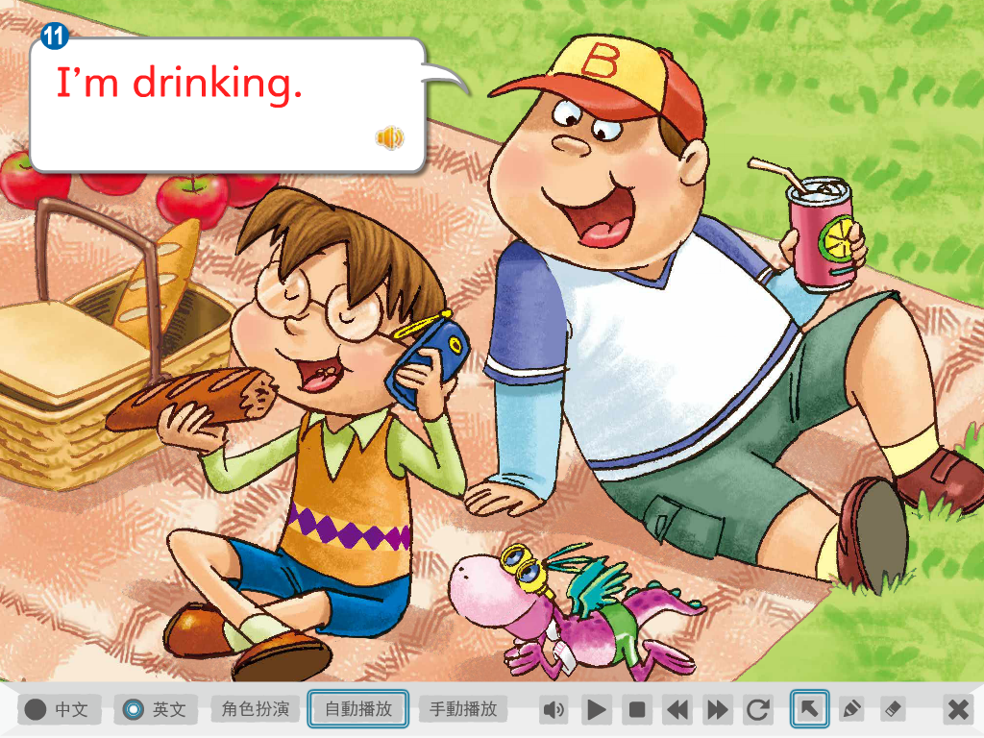

Slide 15
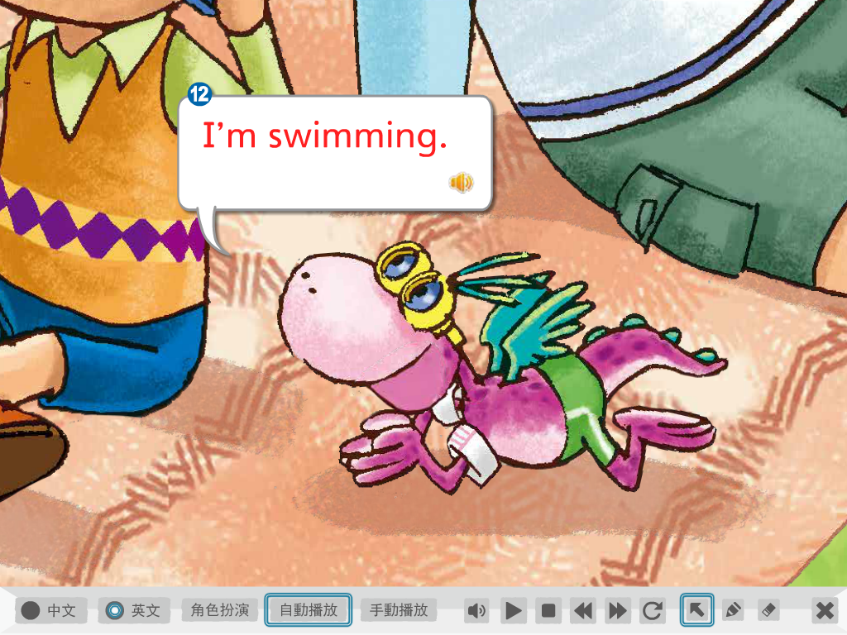

Slide 18
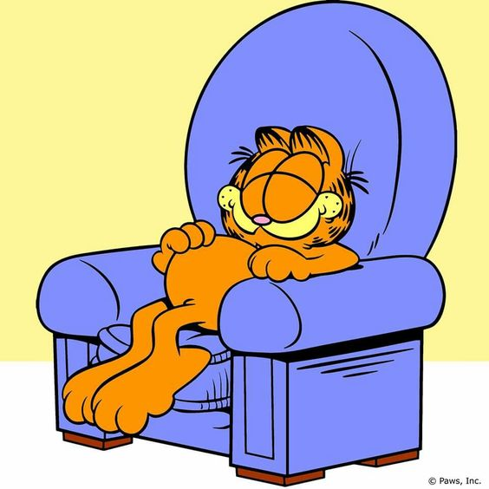
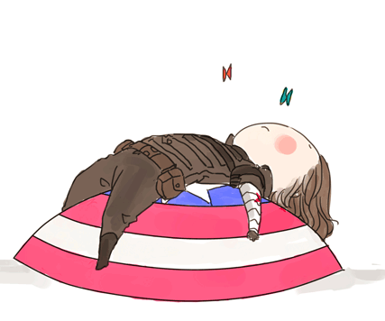
Daily Talk
Take a rest.

Slide 19
Daily Talk
Come and join us.

Slide 21
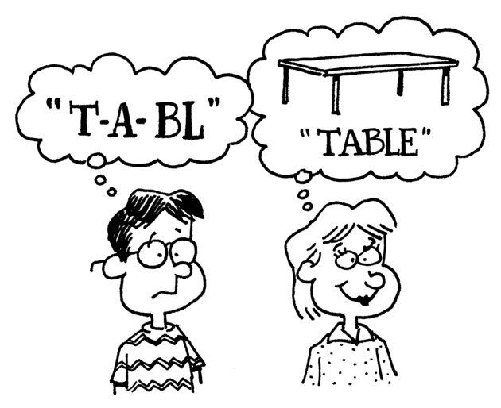
Phonics Time p32~33

Slide 22
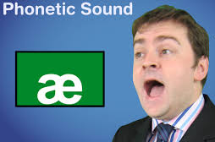
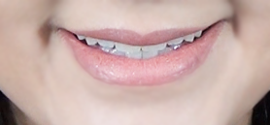
a
a
e

Slide 23
a

Slide 24
c
p
a

Slide 25
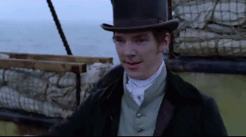
h
t
a

Slide 26
a
e

Slide 27
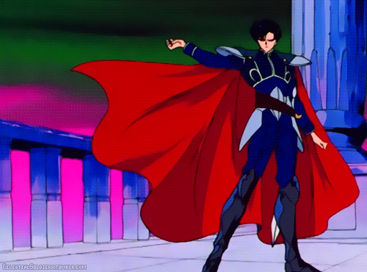
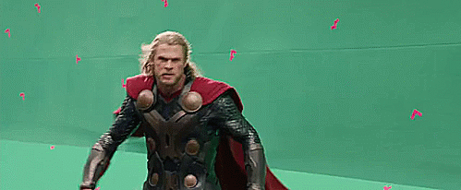
c
p
a
e

Slide 28
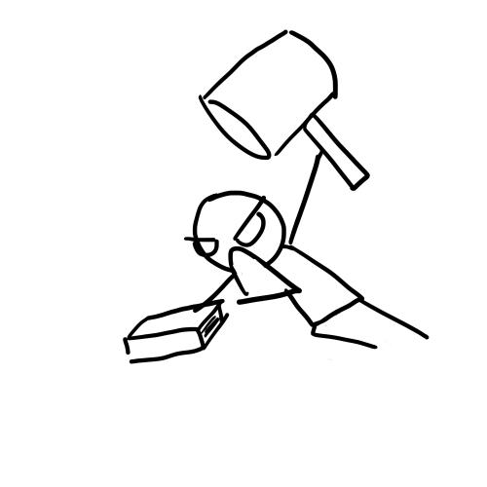
h
t
a
e

Slide 29
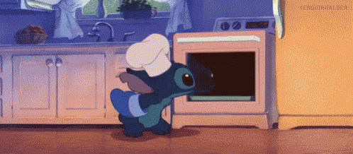
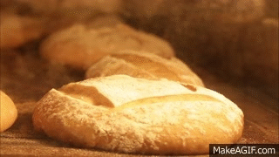
b
k
a
e

Slide 30
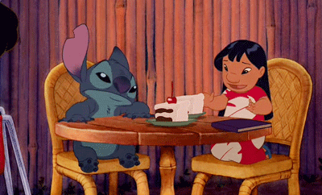
c
k
a
e

Slide 31
This is a cape.
That is a hat.
I like the cape.
I hate the hat.

Slide 32
e
e
e

Slide 33
e

Slide 34
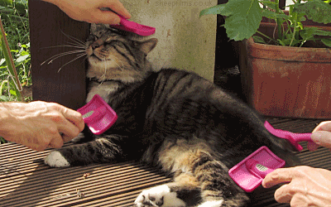
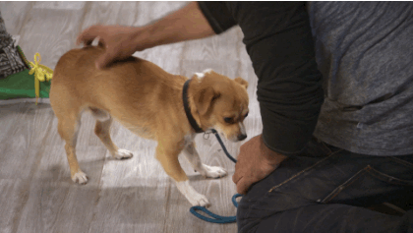
p
t
e

Slide 35
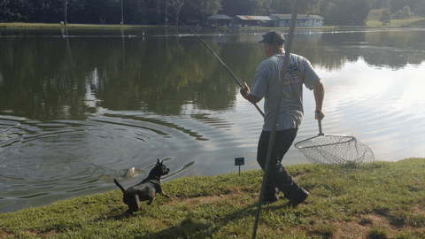
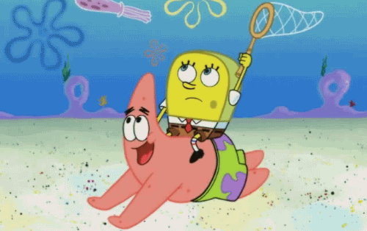
n
t
e

Slide 36
e
e

Slide 37
P
t
e
e

Slide 38
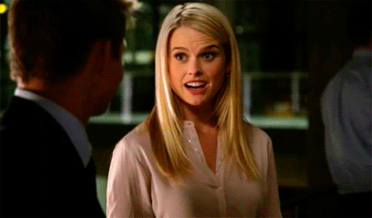
v
E
e

Slide 39
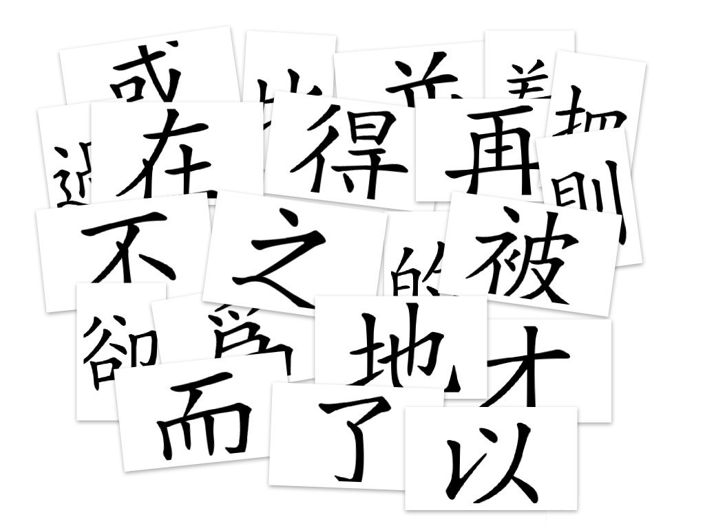
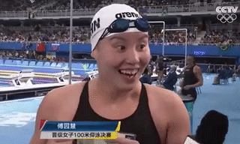
Chin
s
e
e

Slide 40
He is Pete.
Pete has a pet.
She is Eve.
Eve has a net.
Pete and Eve can speak Chinese of pet and net.

Slide 41
i
i
e

Slide 42
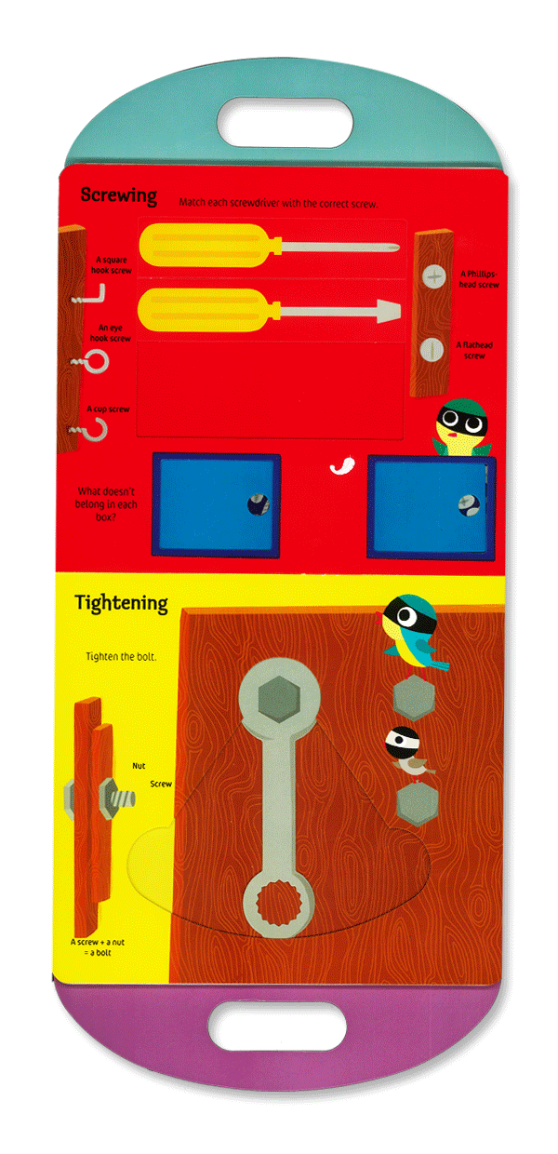
k
t
i

Slide 43
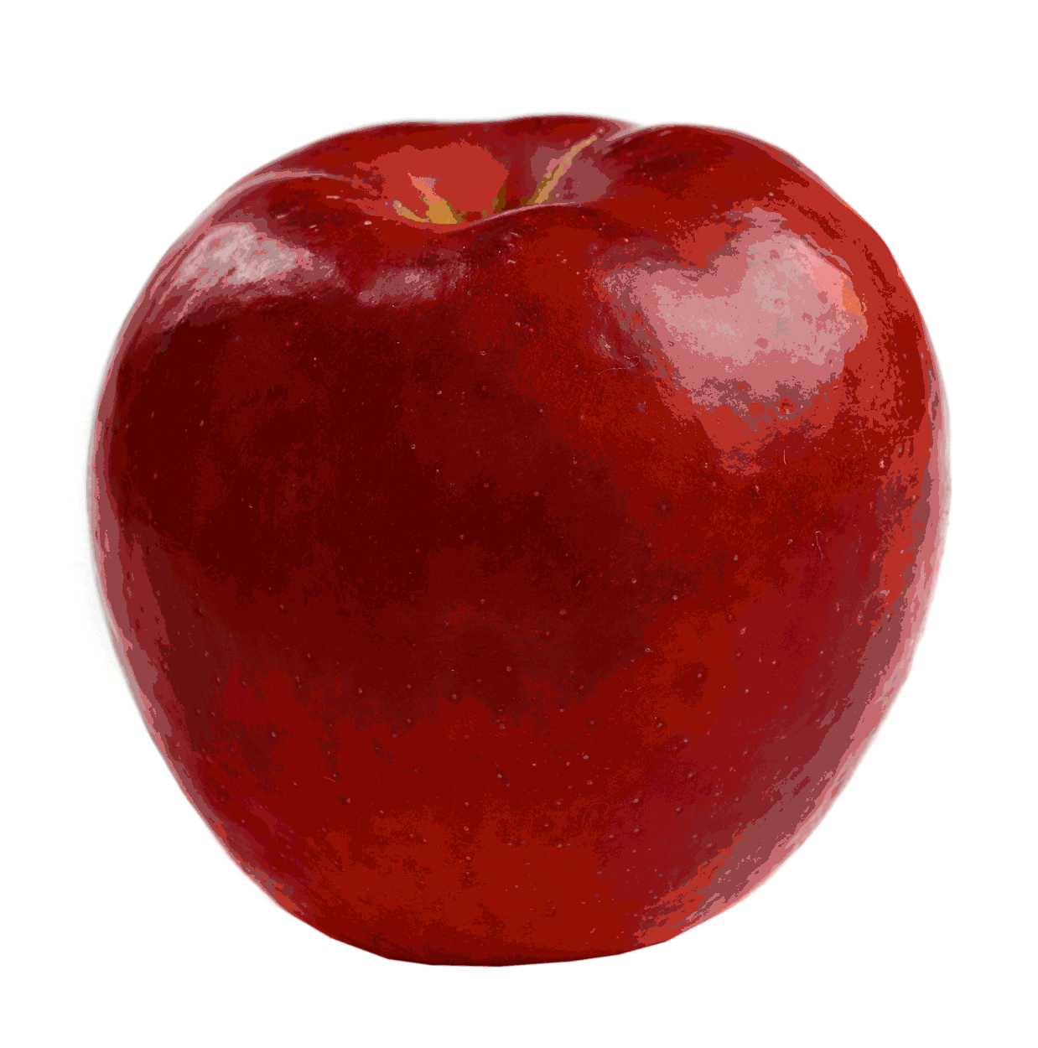
p
p
i

Slide 44
The words with “i” sounds

Slide 45
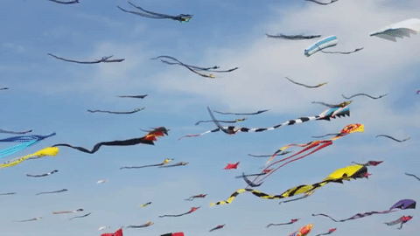
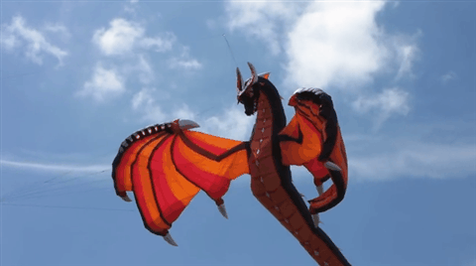
k
t
i
e

Slide 46
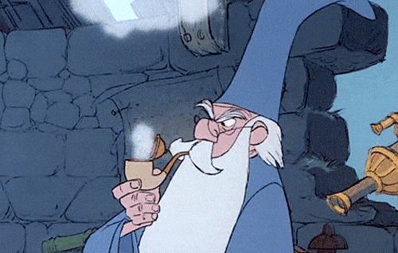
p
p
i
e

Slide 47
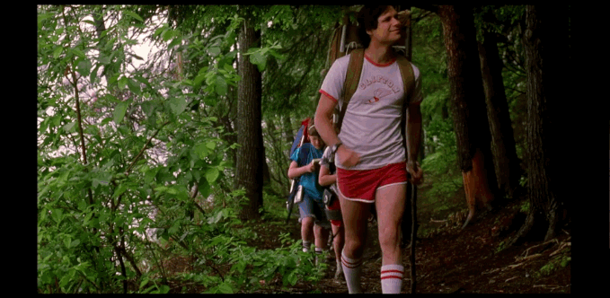
h
k
i
e

Slide 48
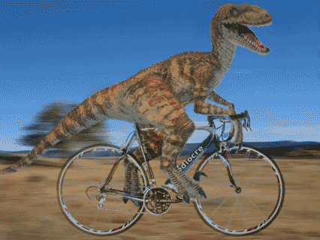
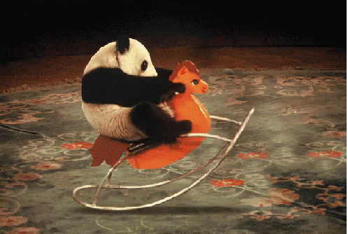
r
d
i
e

Slide 49
The words with “i_e” sounds

Slide 50
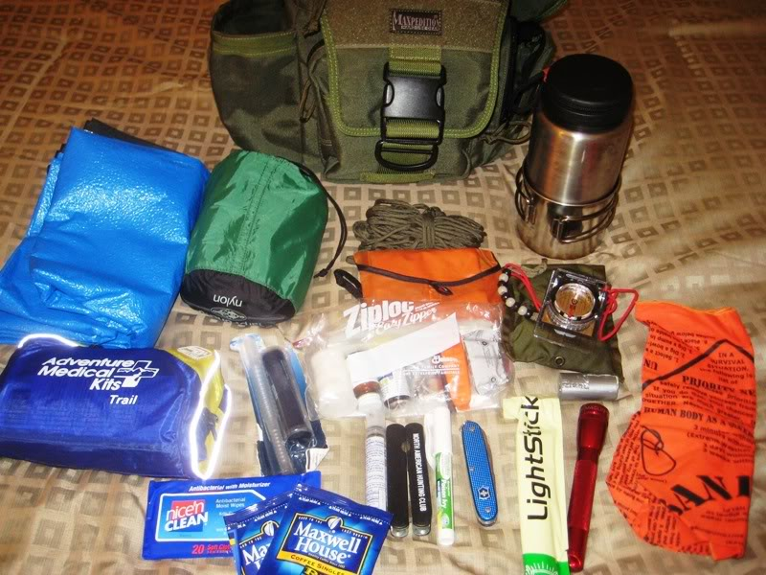
Hike with a kit.

Slide 51
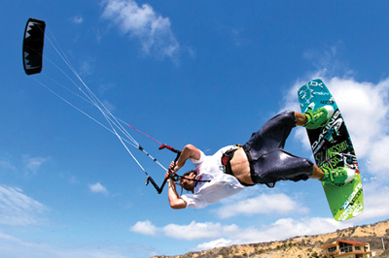
Ride with a kite.

Slide 52
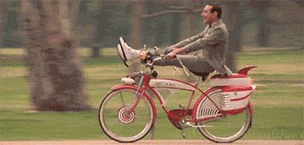
Let’s hike and ride a bike.

Slide 53
Hike with a kit.
Ride with a kite.
Let’s hike and ride a bike.

Slide 55
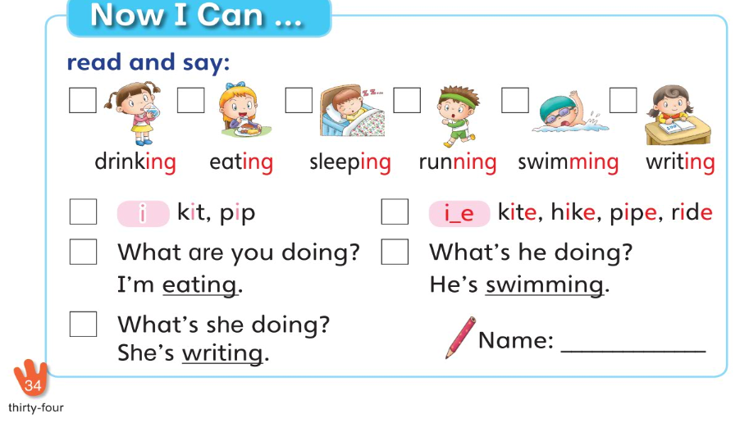

Slide 56
【第九週英語作業】
1. 課本P34頁內容，請家長協助認證簽名。
★下週前兩節英文課要進行期中多元評量，內容為Starter Unit~Unit2全。除單字&句型檢核外，會分組進行課文&歌曲發表，可多聽CD或上Mandy老師的網頁複習。→要背單字

Slide 57
a
a
e
e
e
e
i
i
e

